Slide 1



DEPI Graduation Project
Suppliers Chain Quality Project

Slide 2






Our Professor:
Eng. Yasser Abdulrahman
Mohamed Selim
Youssef Ismail
Ahmed Yahia
Ahmed Hany
Ahmed Ayman

Slide 3
Table of contents
01
02
03
04
05
06
Data Overview
Tech Report
Analytical Report
Summary of tables, Metadata, and dataset structure.
Steps for data cleaning and preparation explained.
Key trends and findings from the data analysis.
Take aways
Next Step
Executive Summary
Business recommendations based on the analysis.
Future actions or areas for further investigation.
Summary of insights and alignment with business goals.

Slide 4
01
Data Overview

Slide 5
About The Data
This is an analysis project of Suppliers "Vendors" Quality and Manufacturing Downtime. Here we deal with a data set of how much some vendors' materials quality is.
We aim for two main objectives:
To understand who the best and worst suppliers are.
Identify which plants do a better job finding and rejecting defects, to minimize downtime.
Downtime is the Time during which production is stopped, during setup for an operation, when making repairs, or when stoppages occur due to supply or labor shortages. Defects are imperfections or errors of any type that affect materials.

Slide 6
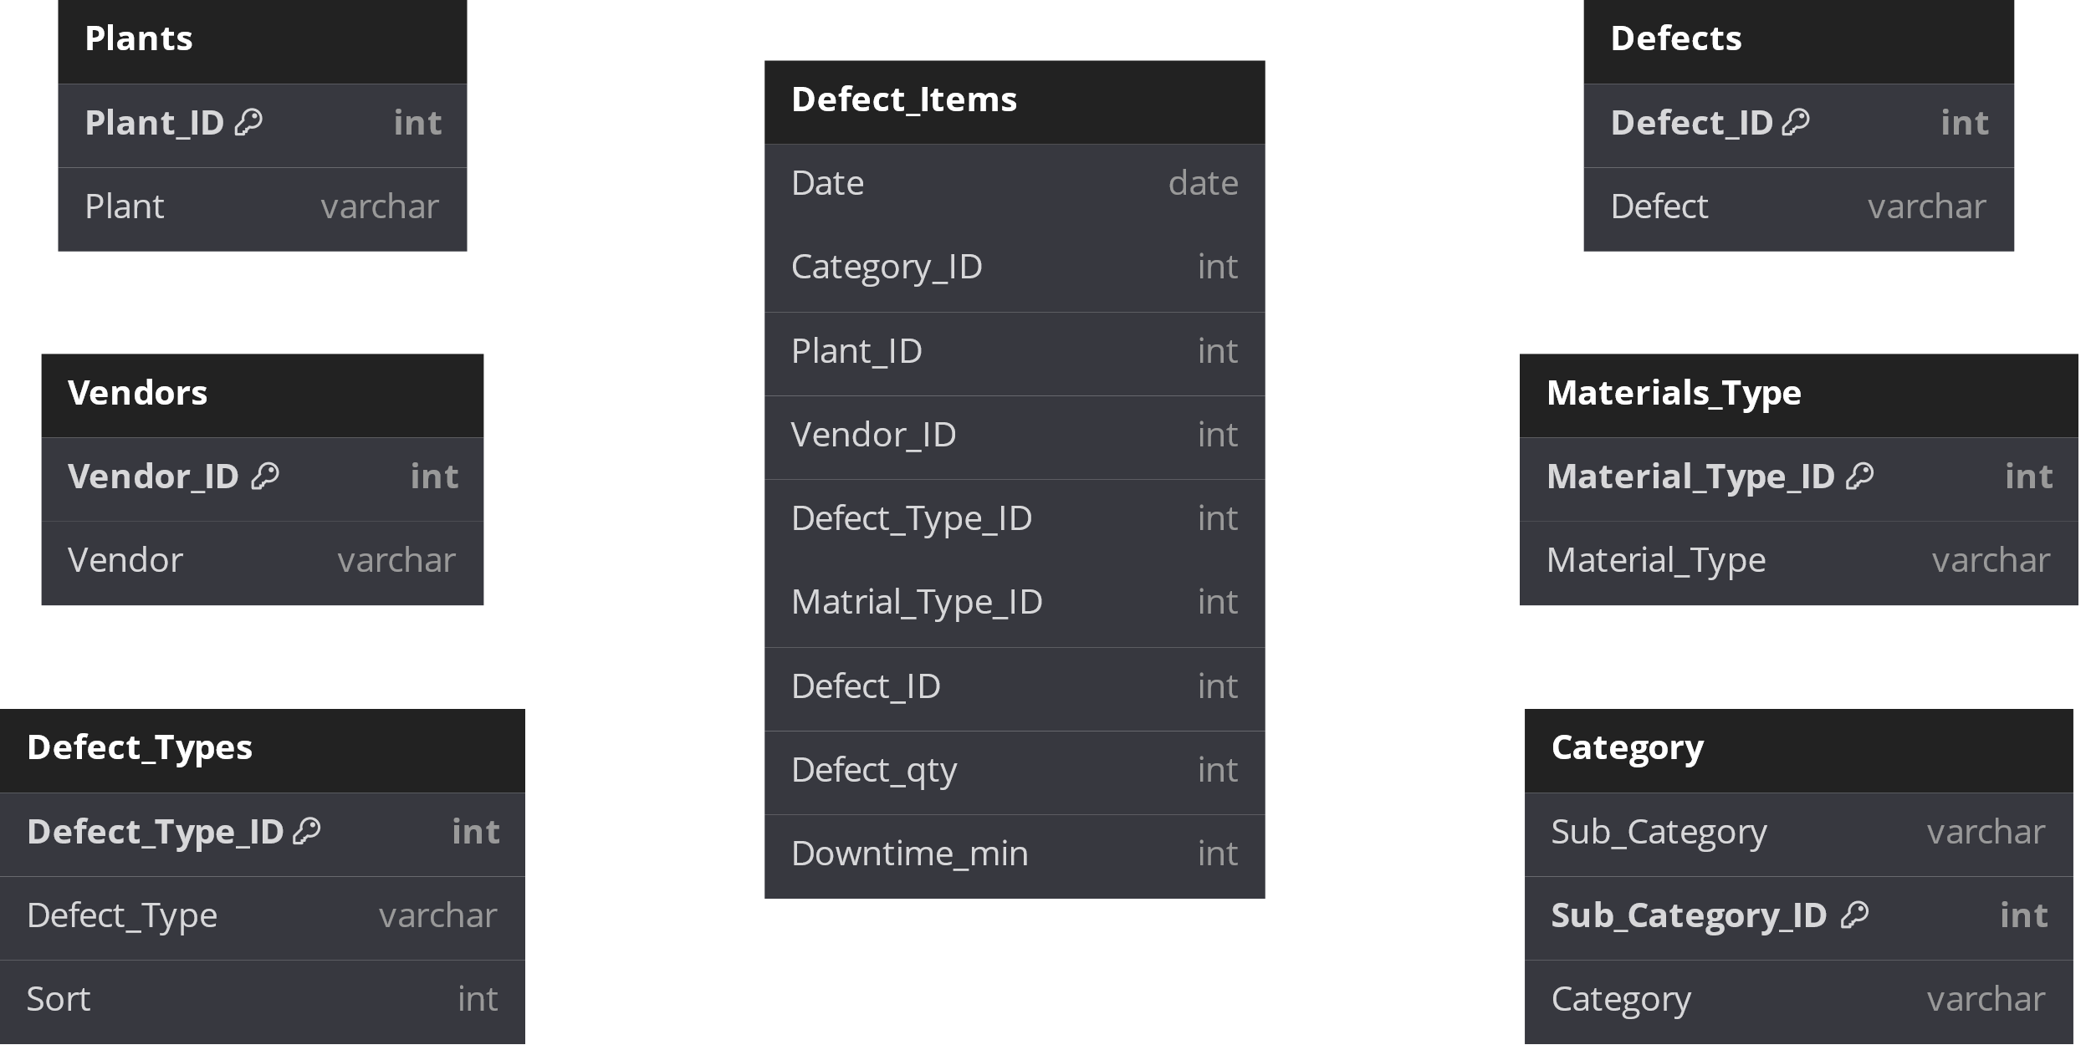
Entity Relationship Diagram
The raw data

Slide 7
02
Technical Report

Slide 8
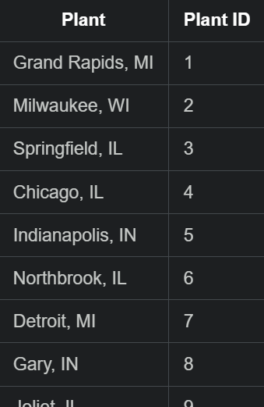
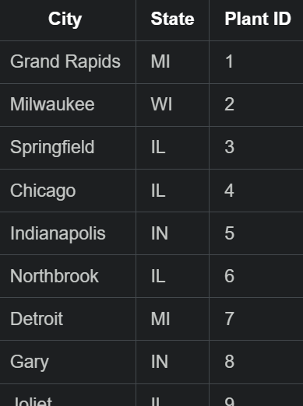
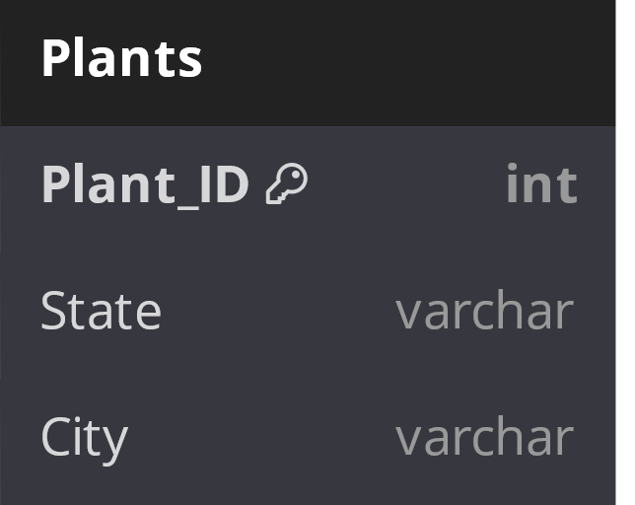
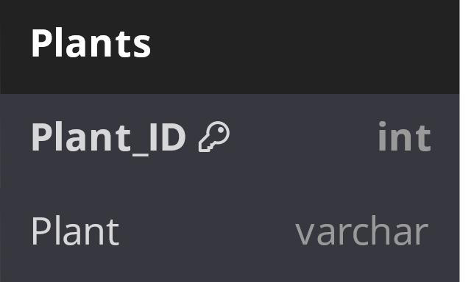
Table Preparation
CREATE TABLE NewPlants (
City VARCHAR(255),
State CHAR(2),
Plant_ID INT PRIMARY KEY
);
INSERT INTO newplants (City, State, Plant_ID)
SELECT
SUBSTRING_INDEX(Plant_Name, ',', 1) AS City,
CASE
WHEN Plant_Name REGEXP '.*, [A-Z]'
THEN SUBSTRING_INDEX(Plant_Name, ', ', -1)
WHEN Plant_Name REGEXP '.* [A-Z]'
THEN SUBSTRING_INDEX(Plant_Name, ' ', -1)
ELSE RIGHT(Plant_Name, NULL)
END AS State,
Plant_ID
FROM Plants;
SQL

Slide 9
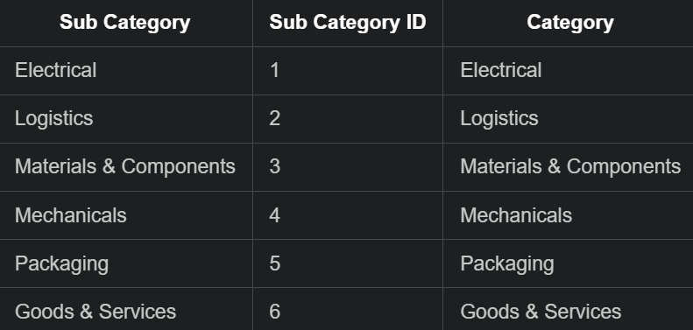
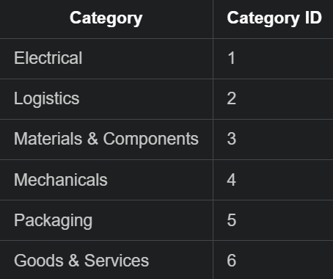

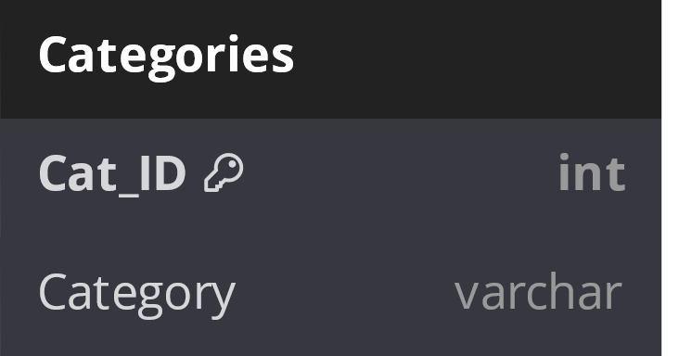
Table Preparation
ALTER TABLE Categories
DROP COLUMN Sub_Category,
RENAME COLUMN Sub_Category_ID TO Category_ID;
SQL

Slide 10
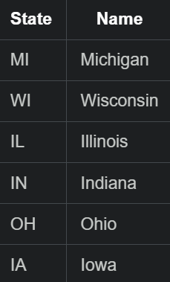
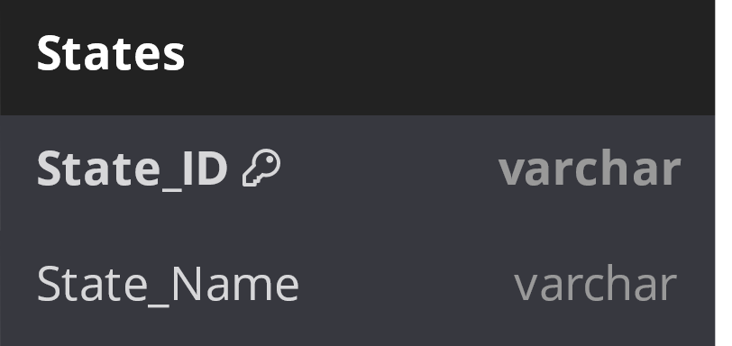
Table Preparation
CREATE TABLE IF NOT EXISTS States(
State_ID VARCHAR(2) PRIMARY KEY,
State_Name VARCHAR(125)
);
INSERT INTO States (State_ID,State_Name)
VALUES
('MI','Michigan'),
('WI','Wisconsin'),
('IL','Illinois'),
('IN','Indiana'),
('OH','Ohio'),
('IA','Iowa');
SQL

Slide 11
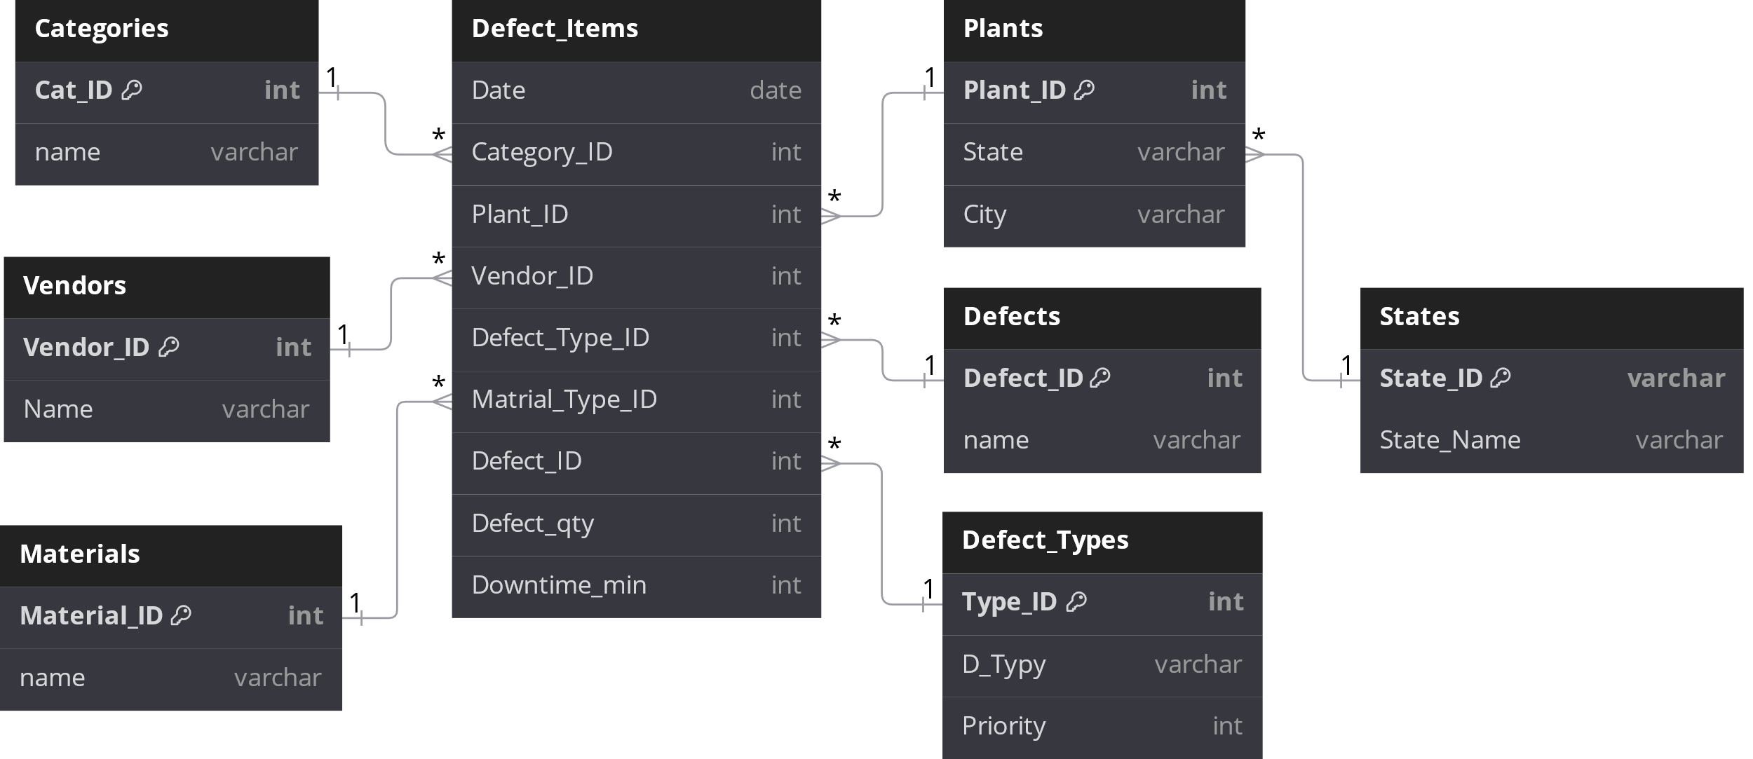
Entity Relationship Diagram
Data after the preparation

Slide 12
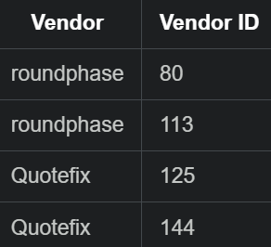
Data Cleaning
Remove duplicates
print(df.duplicated()) df.loc[[80,113,125,144]] df.drop_duplicates(inplace = True)
Python
Remove duplicates

Slide 13
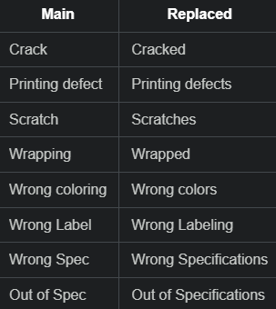
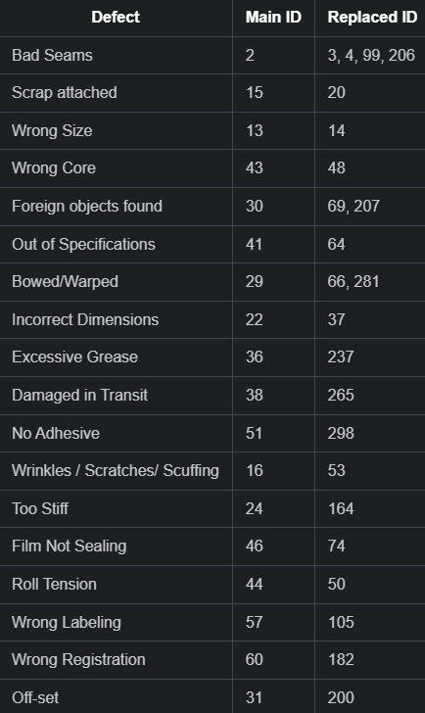
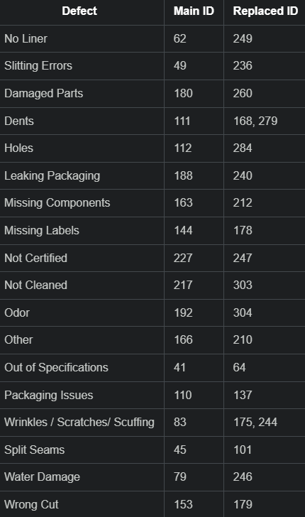
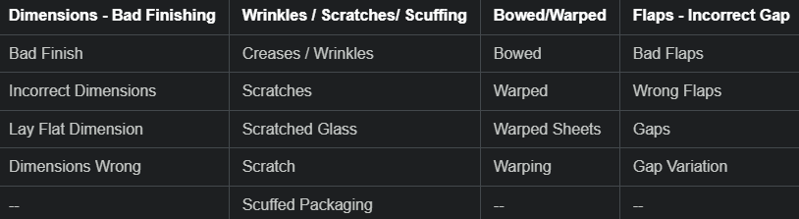
Data Cleaning
Remove duplicates
Step #01
Step #03
Step #02

Slide 14
Data Cleaning
Remove duplicates
Step #01 & Step #02
import pandas as pd
df = pd.read_excel(r"C:dataset.xlsx", sheet_name="Defects")
replacements = {
'Crack': 'Cracked','Printing defect': 'Printing defects','Scratch': 'Scratches',
'Wraped': 'Wraping','Wrong coloring': 'wrong colors’,
'Wrong Label': 'Worng Labeling','Wrong Spec': 'Wrong Specifications',
'Out of Spec': 'Out of Specifications','Creases / Wrinkles': 'Wrinkles / Scratches / Scuffing',
'Scratches': 'Wrinkles / Scratches / Scuffing','Scratched Glass': 'Wrinkles / Scratches / Scuffing',
'Scratch': 'Wrinkles / Scratches / Scuffing','Scuffed Packeging': 'Wrinkles / Scratches / Scuffing',
'Bowed': 'Bowed/Warped','Warped': 'Bowed/Warped',
'Warped Sheets': 'Bowed/Warped','Warping': 'Bowed/Warped',
'Bad Flaps': 'Flaps - Incorrect Gap','Wrong Flaps': 'Flaps - Incorrect Gap',
'Gaps': 'Flaps - Incorrect Gap','Gap Variation': 'Flaps - Incorrect Gap',
'Bad Finish': 'Dimensions - Bad Finishing','Incorrect Dimensions': 'Dimensions - Bad Finishing',
'Lay Flat Dimension': 'Dimensions - Bad Finishing','Dimensions Wrong': 'Dimensions - Bad Finishing'
}
Python

Slide 15
Data Cleaning
Remove duplicates
Step #01 & Step #02
replaced_values = []
for old_value, new_value in replacements.items():
if old_value in df['Defect'].values:
replaced_values.append((old_value, new_value))
df['Defect'] = df['Defect'].replace(replacements)
for old_value, new_value in replaced_values:
print(f"'{old_value}' replaced with '{new_value}'")
output_file_path = r"C:dataset.xlsx"
df.to_excel(output_file_path, index=False)
print(f"Replacements done and saved to {output_file_path}")
Python

Slide 16
Data Cleaning
Remove duplicates
Step #03
import pandas as pd
file_path = r" C:dataset.xlsx "
duplicates_info = df[df.duplicated(subset=['Defect'], keep=False)]
removed_ids = []
for defect in duplicates_info['Defect'].unique():
ids = duplicates_info[duplicates_info['Defect'] == defect]['Defect ID'].tolist()
if len(ids) > 1:
removed_ids.extend(ids[1:])
df_unique = df.drop_duplicates(subset=['Defect'])
output_file_path = r"C:dataset.xlsx"
df_unique.to_excel(output_file_path, index=False)
if removed_ids:
print("Removed the following IDs due to duplicates:")
for removed_id in removed_ids:
print(removed_id)
else: print("No duplicates found.")
print(f"File saved without duplicates to: {output_file_path}")
Python

Slide 17
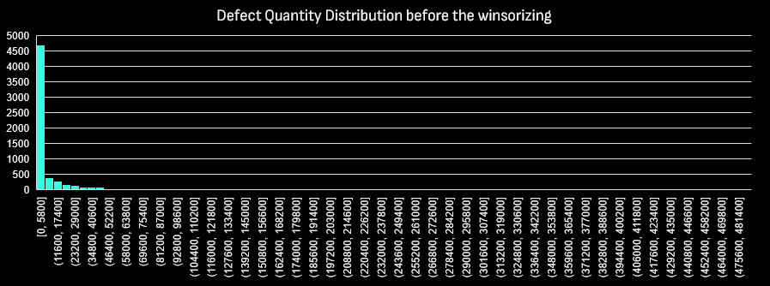
Dealing with outliers
Defect quantity outliers

Slide 18
Dealing with outliers
Defect quantity outliers
import pandas as pd
from scipy.stats.mstats import winsorize
df = pd.read_excel("C:dataset.xlsx")
Q1 = df['Defect Qty'].quantile(0.25)
Q3 = df['Defect Qty'].quantile(0.75)
IQR = Q3 - Q1
lower_bound = Q1 - 1.5 * IQR
upper_bound = Q3 + 1.5 * IQR
print(f"Lower bound for Winsorizing: {lower_bound}")
print(f"Upper bound for Winsorizing: {upper_bound}")
original_count = df['Downtime min'].count()
df.loc[df['Defect Qty'] < lower_bound, 'Defect Qty'] = lower_bound
df.loc[df['Defect Qty'] > upper_bound, 'Defect Qty'] = upper_bound
adjusted_count = df.loc[(df['Defect Qty'] < lower_bound) | (df['Defect Qty'] > upper_bound), 'Defect Qty'].count()
print(f"Handled Defect Qty outliers with Winsorizing.")
df.to_excel("C:dataset.xlsx", index=False)
print("Data saved to 'dataset.xlsx'.")
Python

Slide 19
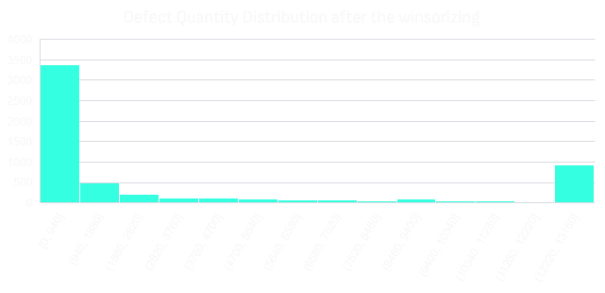
Dealing with outliers
Defect quantity outliers

Slide 20
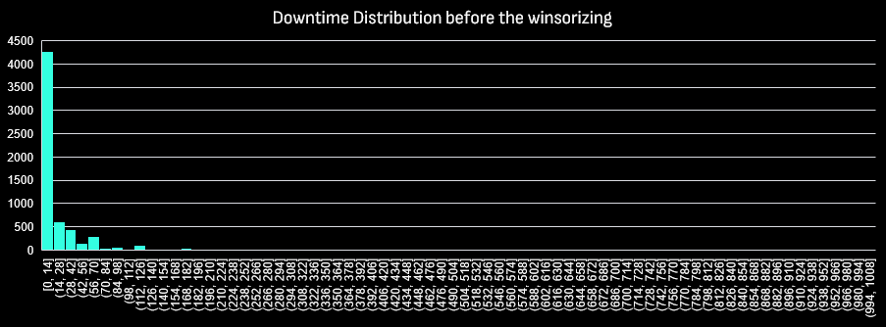
Dealing with outliers
Downtime outliers

Slide 21
Dealing with outliers
Downtime outliers
import pandas as pd
from scipy.stats.mstats import winsorize
df = pd.read_excel("C:dataset.xlsx") Q1 = df['Downtime min'].quantile(0.25)
Q3 = df['Downtime min'].quantile(0.75)
IQR = Q3 - Q1
lower_bound = Q1 - 1.5 * IQR
upper_bound = Q3 + 1.5 * IQR
print(f"Lower bound for Winsorizing: {lower_bound}")
print(f"Upper bound for Winsorizing: {upper_bound}")
original_count = df['Downtime min'].count()
df.loc[df['Downtime min'] < lower_bound, 'Downtime min'] = lower_bound
df.loc[df['Downtime min'] > upper_bound, 'Downtime min'] = upper_bound
adjusted_count = df.loc[(df['Downtime min'] < lower_bound) | (df['Downtime min'] > upper_bound), 'Downtime min'].count()
print(f"Handled Downtime outliers with Winsorizing.")
df.to_excel("C:dataset.xlsx", index=False)
print("Data saved to 'dataset.xlsx'.")
Python

Slide 22
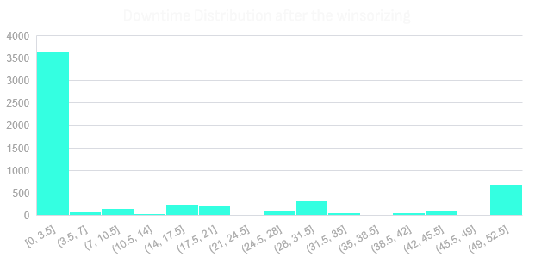
Dealing with outliers
Downtime outliers

Slide 23
Data Modeling
dCategory
dDefect Type
dDefects
fDefect Items
dMatrial Type
dPlant
dCity
dVendor

Slide 24
03
Analytical Report

Slide 25
5951Inspections
11.46mins
3293defect
Number of Inspections
AVG down time in Mins
AVG Defects Quantity

Slide 26
Defect Quantity By Defect Type
32%
33%
35%
Rejected
Impact
No Impact
Rejected and Impact product has about 65% of the total defects

Slide 27
AVG Downtime by Defect type
No Impact: Low downtime
Rejected: Downtime is slightly above 8 minutes, comparable to "No Impact."
Impact: The highest downtime (close to 30 minutes on average)
indicating that defects labeled as "Impact" cause significant operational delays.

Slide 28
AVG Downtime & Defect Qty by Defect type
The highest downtime occurred in the "Impact" category with 27.65 minutes.
"No Impact" has the lowest downtime at 1.36 minutes despite having the highest defect quantity (35%).
Both "Impact" and "Rejected" categories have similar defect quantities, but the downtime is much higher for "Impact."

Slide 29
Vendors

Slide 30
Defect quantity by Top 5 vendors
Dentocity leads with the highest defect quantity, close to 1.4 million, indicating they are a significant contributor to defects among the top vendors.
Quotelane follows closely behind with over 1.2 million defects, showing a similarly high defect contribution.
ontotam shows a moderate defect count, just under 1 million.
Plustax and Solholdings have relatively lower defect quantities, both around 800,000, though still considerable compared to the top two vendors.

Slide 31
Downtime for Top 5 vendors
Plustax has the highest average downtime, exceeding 16 minutes, indicating they may be causing significant operational delays.
Solholdings follows closely with an average downtime of about 15 minutes.
Dentocity and ontotam have moderate downtime levels, both around 13 to 14 minutes, showing some impact but not as severe as the top two.
Quotelane shows the lowest average downtime (around 11 minutes), making them the least disruptive vendor in terms of downtime.

Slide 32
Defect Types of Top 5 Vendors
Vendors | Impact | No Impact | Rejected | Grand Total
Dentocity | 34% | 28% | 38% | 100%
Quotelane | 31% | 36% | 33% | 100%
ontotam | 45% | 18% | 37% | 100%
Plustax | 70% | 23% | 8% | 100%
Solholdings | 27% | 15% | 59% | 100%
Grand Total | 40% | 25% | 35% | 100%
40% of the top 5 vendor’s defective quantities are of the impact type. Because of that, their average downtime is high.

Slide 33
Material Type

Slide 34
Avg Down Time by Top 5 Material Type
Corrugated Materials Dominate Downtime: Corrugated materials experience the highest average downtime among the five categories, significantly surpassing the others.
Consistency in Downtime for Carton, Film, and Labels: Carton, film, and labels exhibit relatively similar levels of average downtime, suggesting a moderate degree of consistency in their operational disruptions.
Raw Materials Lag Behind: Raw materials have the lowest average downtime, indicating a potentially more stable or efficient supply chain or production process compared to the other materials.

Slide 35
Defect Type Comparison for Top 2 Materials
Corrugated and Carton are the top 2 material types in average downtime. This is because most of their defective quantities are of the impact type.

Slide 36
Material Matters: Defect Quantity Disparity
Raw materials experience the least defect quantity, while corrugated materials have the highest.
Film, carton, and labels exhibit similar levels of defect quantity.

Slide 37
The Impact of Top 5 Vendors on Material Types
The most defective material types of the top 5 vendors are labels, cartoons, and films. This makes these four material types have high defective quantities.

Slide 38
State

Slide 39
Iowa and Ohio Outliers: State-Level Downtime Disparity
Iowa and Ohio Lead in Downtime: Iowa and Ohio experience the highest average downtime, suggesting potential operational challenges or disruptions in these states.
Michigan, Wisconsin, and Illinois Follow: These states exhibit moderate levels of downtime, indicating a need for further investigation into potential causes.
Indiana Has Lowest Downtime: Indiana demonstrates the lowest average downtime, suggesting more efficient operations or fewer disruptions compared to the other states.

Slide 40
Defect Type Disparity in Top States
Iowa's Dominance in Rejected Defects: Iowa has the highest percentage of rejected defects, indicating potential quality control issues or non-compliance with standards.
Michigan's Balanced Defect Types: Michigan exhibits a more balanced distribution of defect types, with a significant portion having no impact, suggesting that while defects occur, they may not always result in major consequences.
Ohio's Impact-Focused Defects: Ohio has a higher proportion of defects that have an impact, suggesting that while the overall defect rate may be lower, the defects that do occur are more likely to cause problems.

Slide 41
State-by-State Defect Disparity
Illinois Leads in Defects: Illinois experiences a significantly higher number of defects compared to the other states, indicating a potential quality control issue or other underlying factors.
Michigan and Indiana Follow: Michigan and Indiana report substantial defect quantities, suggesting similar challenges in quality or production processes.
Wisconsin, Ohio, and Iowa Show Lower Defects: These states exhibit considerably fewer defects, potentially due to more effective quality management practices or different production conditions.

Slide 42
Vendor State Drives Defect Dominance
Michigan Dominates Defects: Michigan accounts for nearly half (49%) of the total defects, indicating a significant quality issue or other underlying problem with vendors from this state.
Illinois and Indiana Follow: Illinois and Indiana contribute substantial portions of the defects, suggesting that quality challenges may also exist among vendors in these states.
Other States' Influence: The remaining 20% of defects are attributed to vendors from other states, highlighting a more diverse range of quality issues across the vendor base.

Slide 43
Category

Slide 44
Logistics and Packaging Lag: Category-Based Downtime Disparity
Logistics and Packaging Lead in Downtime: Logistics and packaging experience the highest average downtime, indicating potential challenges or disruptions in these areas.
Goods & Services Follow: Goods & Services have a moderately high level of downtime, suggesting that issues in this category may also contribute to overall operational inefficiencies.
Mechanical and Materials & Components Lag Behind: Mechanicals and Materials & Components exhibit significantly lower downtime, suggesting more stable or efficient processes in these areas.

Slide 45
Defect Type Disparity in Top 3 Categories
Goods & Services Lead in Rejected Defects: Goods & Services have the highest percentage of rejected defects, indicating potential quality control issues or non-compliance with standards.
Logistics and Packaging Exhibit Similar Defect Profiles: Logistics and packaging show comparable distributions of defect types, with a higher proportion of defects having no impact.
Impactful Defects in Logistics and Packaging: While rejected defects are higher in Goods & Services, Logistics and Packaging still have a significant percentage of defects that have an impact, suggesting potential operational or quality issues.

Slide 46
Defect Type Disparity in Top 3 Categories
Mechanical Defects Dominate: Mechanical defects far outnumber defects in other categories, indicating a significant quality issue or underlying problem in this area.
Packaging and Logistics Follow: Packaging and logistics also experience a relatively high number of defects, suggesting potential challenges in these areas.
Materials & Components, Goods & Services, and Electrical Lag Behind: These categories exhibit significantly fewer defects, potentially due to more effective quality management or different production processes.

Slide 47
Logistics Leadership: Vendor Category Dominance
Logistics Dominates Vendor Categories: Logistics accounts for a significant portion (40%) of the top 5 vendors, suggesting that this category plays a crucial role in the supply chain or overall business operations.
Packaging and Mechanics Follow: Packaging and Mechanics each represent 22% of the top 5 vendors, indicating their importance in the supply chain as well.
Other Categories Contribute: The remaining 19% is distributed among other categories, suggesting a diverse range of vendors involved in the business.

Slide 48
Date

Slide 49
Summer Surge: Downtime Fluctuations Throughout the Year
Initial Decrease: The trend line starts with a decline from January to February, suggesting an improvement in operational efficiency or a reduction in disruptions during that period.
Mid-Year Spike: A significant increase in downtime occurs between June and July, indicating potential challenges or disruptions during this timeframe.
Summer Recovery: The line then dips back down from July to September, suggesting a recovery in operational performance.
Late-Year Upsurge: A final spike in downtime is observed from October to December, indicating potential issues or challenges towards the end of the year.

Slide 50
Impact Type Trend Analysis
Initial Decline: The trend line starts with a decrease from January to February, suggesting a reduction in the impact of defects or issues during that period.
Mid-Year Fluctuations: The line exhibits fluctuations between March and August, indicating varying levels of impact throughout this timeframe.
Late-Year Stability: The trend line becomes relatively stable from September to December, suggesting a more consistent level of impact.

Slide 51
Impact Type Trend Analysis
Initial Decline: The trend line starts with a decrease from January to February, suggesting a reduction in defect quantity during that period.
Mid-Year Fluctuations: The line exhibits fluctuations between March and October, indicating varying levels of defects throughout this timeframe.
Late-Year Surge: A significant increase in defects occurs from October to November, followed by a sharp decline in December.

Slide 52
Early Improvement: Defect Quantity Trend for Top 5 Vendors
Initial Decline: The trend line starts with a decrease from January to February, suggesting an improvement in quality or a reduction in defects from the top 5 vendors during that period.
Mid-Year Fluctuations: The line exhibits fluctuations between March and August, indicating varying levels of defect quantity among the top 5 vendors.
Late-Year Stability: The trend line becomes relatively stable from September to December, suggesting a more consistent level of defects from these vendors.

Slide 53
Avg Defect Quantity Timeline
2014 experiences more volatility with significant peaks and drops, while 2013 has a more gradual trend. The highest point in both years occurs in June, but 2014 generally displays more variability throughout the period.

Slide 54
Defect Category by years
2014 shows large increases in Raw Materials and Film compared to 2013.
Labels had higher value in 2013.
Carton and Corrugate categories show similar performance across both years

Slide 55
Downtime of Categories by years
2014 shows large increases in Corrugate and Film compared to 2013.
Corrugate had higher value in 2013.
Raw Materials and labels categories show similar performance across both years

Slide 56
Dashboards

Slide 57
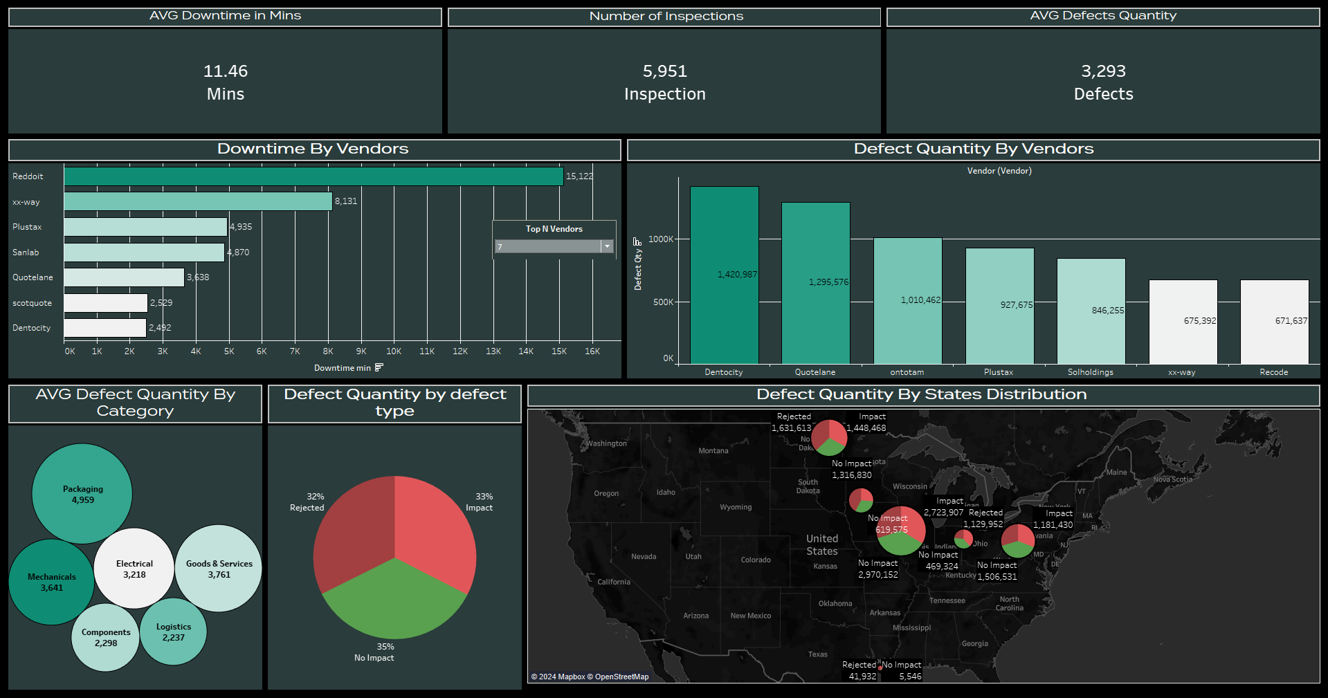

Slide 58
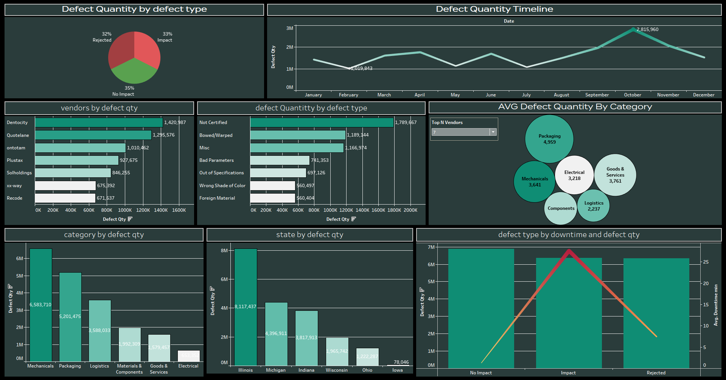

Slide 59
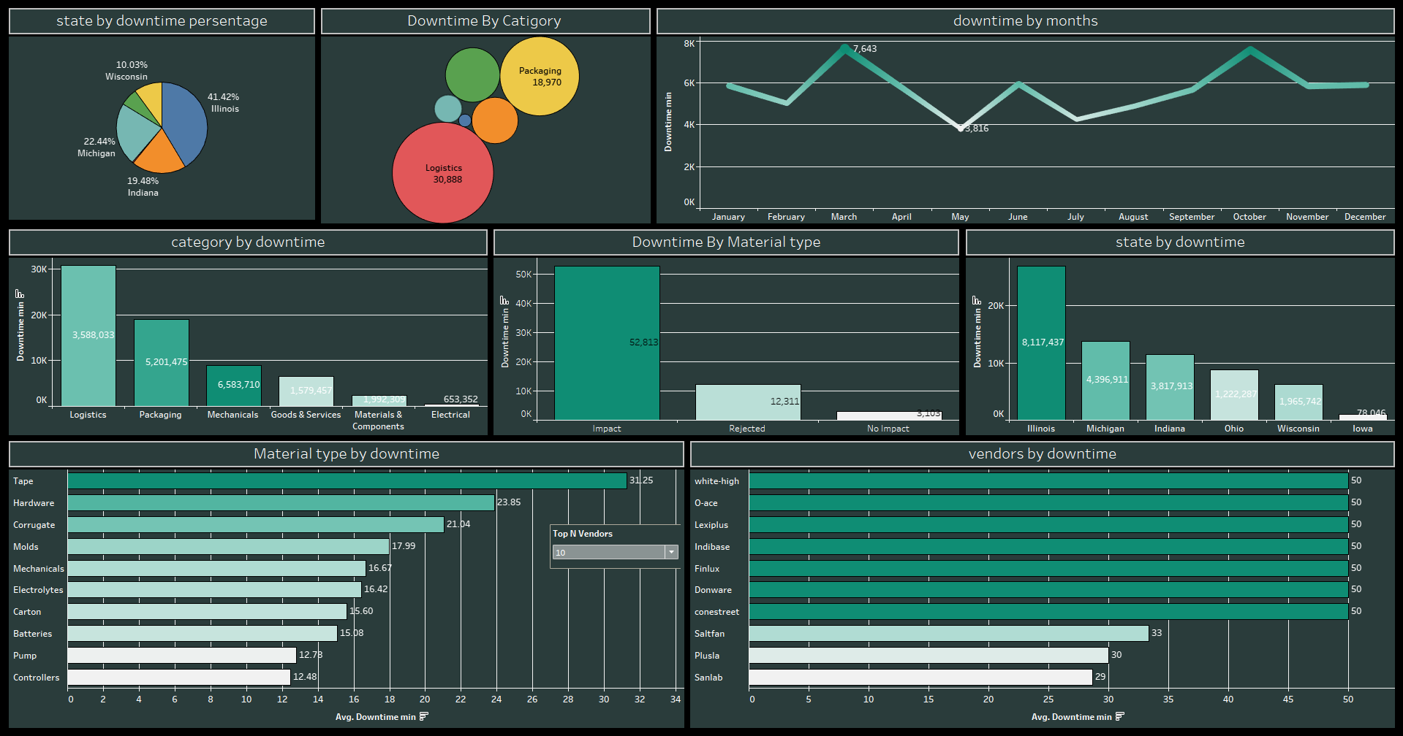

Slide 60
04
Take aways

Slide 61
1. Supplier Performance Evaluation:
Top Contributors to Defects: Vendors like Dentocity and Quotelane contribute the highest defect quantities, indicating they need closer scrutiny and possible renegotiation of contracts or improvements in quality control processes.
Plustax and Solholdings also show high downtime, suggesting that these suppliers could be causing operational inefficiencies, even if their defect quantities are lower.
2. Operational Efficiency through Downtime Reduction:
Impact of Defect Types: Defects classified as "Impact" lead to the highest downtime, averaging around 27 minutes. This suggests a need for better preventative measures in identifying and reducing high-impact defects to improve overall operational efficiency.
No Impact Defects: While "No Impact" defects are most frequent, they have minimal effect on downtime, suggesting that the business can tolerate such defects if prioritized correctly.
3. Material and Vendor Strategy:
Material-Type Focus: Corrugated materials lead to average downtime, signaling potential issues in the handling or sourcing of this material. Investing in better quality or optimizing processes related to corrugated materials could reduce downtime significantly.
State Disparities: States like Iowa and Ohio face the highest downtime, meaning-focused improvements on operations in these regions can lead to overall efficiency gains.

Slide 62
4. Supply Chain Optimization:
Logistics and Packaging Downtime: Categories such as Logistics and Packaging experience the highest average downtimes, indicating that these are the areas in most need of process improvement.
Material Management: Raw materials exhibit the least downtime and defect quantity, suggesting this part of the supply chain is functioning efficiently. It could be used as a model for improving other material types.
5. Seasonal Trends and Preparation:
Mid-Year and Late-Year Challenges: The business experiences downtime spikes in the mid-year (June-July) and at the end of the year (October-December). This suggests potential seasonal challenges, such as labor shortages or higher defect rates during peak production periods. Preparing for these challenges in advance with resource allocation and process improvements could mitigate their impact.
6. Focus on Key States:
State-Specific Issues: Michigan and Illinois lead in defect quantity, with Michigan accounting for nearly 50% of total defects. These states may benefit from targeted quality control interventions and supplier reviews to reduce defects and improve efficiency.
7. Vendor and Material Type Interactions:
Vendor-Material Relationships: Labels, cartons, and films are the most defective material types associated with top vendors. Focusing on these specific vendor-material relationships could yield improvements in reducing overall defect rates.
These insights provide clear directions for optimizing supplier quality, reducing downtime, and strategically managing high-impact defects.

Slide 63
05
Next Step

Slide 64
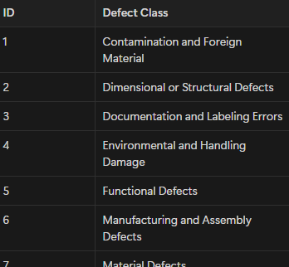
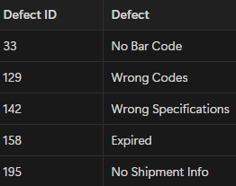
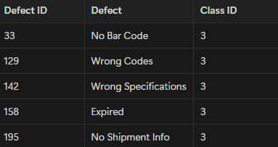
Data Grouping
An important future work is to classify “defects” into data groups so they’ll be easy to use for
analysis. Plus, the information extracted from them will be really useful for a high-level and
public audience. It’s a perfect step to using existing GenAI models or to design a model that is
fed by related business-domain data, which is the supply-chain business domain, vendors’
materials data and the defects commonly occurring to them.
For example, we can notice that many “defects” data records have a common problem or that
describes nearly the same thing, as clarified in the attached sample of data.

Slide 65
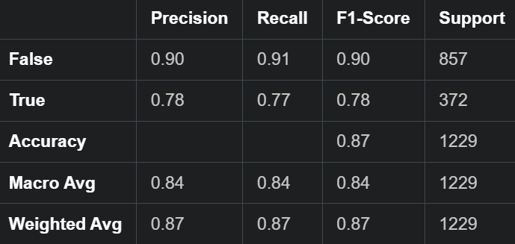
Data Prediction
Defect Classification using Support Vector Machine (SVM) with Categorical Encoding and Standardization
This code classifies defects in manufacturing data using an SVM model. It preprocesses categorical features, standardizes the data, and evaluates the model's accuracy and classification performance.

Slide 66
Data Prediction
import pandas as pd
from sklearn.model_selection import train_test_split
from sklearn.preprocessing import LabelEncoder, StandardScaler
from sklearn.svm import SVC
from sklearn.metrics import classification_report, accuracy_score
file_path = '/content/drive/MyDrive/Power Query.csv'
df = pd.read_csv(file_path)
X = df[['Category', 'State', 'City', 'Vendor', 'Material Type', 'Defect Type', 'Defect']]
y = df[['Defect Qty', 'Downtime min']]
y['Label'] = (y['Defect Qty'] > 0) & (y['Downtime min'] > 0) # You can adjust this logic based on your needs
y = y['Label'] # Use this binary label for classification
label_encoders = {}
for column in X.columns:
le = LabelEncoder()
X[column] = le.fit_transform(X[column])
label_encoders[column] = le
X_train, X_test, y_train, y_test = train_test_split(X, y, test_size=0.2, random_state=42)
scaler = StandardScaler()
X_train = scaler.fit_transform(X_train)
X_test = scaler.transform(X_test)
svc_model = SVC(kernel='linear') # You can try other kernels like 'rbf' or 'poly'
svc_model.fit(X_train, y_train)
y_pred = svc_model.predict(X_test)
accuracy = accuracy_score(y_test, y_pred)
print(f"Accuracy: {accuracy:.2f}")
print("Classification Report:")
print(classification_report(y_test, y_pred))
Python

Slide 67
06
Executive Summary

Slide 68
The Summary
Defects and Downtime: Significant downtime is caused by materials from certain vendors, with defects categorized as "Impact" causing the highest operational delays, averaging 27 minutes.
Vendor Performance: Vendors such as Dentocity and Quotelane contribute the highest number of defects, while Plustax and Solholdings have the highest downtime, indicating their materials lead to longer operational interruptions.
Material Types: Corrugated materials contribute the most to downtime, while raw materials show minimal disruption.
State-Level Analysis: Iowa and Ohio exhibit the highest downtime, while Illinois leads in defect quantity, indicating regional differences in quality and efficiency.

Slide 69
Data Cleaning and Preparation:
Python: Used for data manipulation tasks, including handling missing values and standardizing data.
Pandas: Employed for reading, processing, and exporting datasets.
Database and SQL:
PostgreSQL/SQL: SQL queries were used to clean and transform data, create new tables, and insert data into the database.
Outlier Detection:
Winsorization (with Python and Scipy) was applied to handle outliers in defect and downtime data.
Data Modeling:
ERD (Entity Relationship Diagrams): Used to visualize relationships between data entities like defects, vendors, and plants.
Data Prediction:
Support Vector Machine (SVM): A machine learning model used for defect classification, supported by Scikit-Learn for preprocessing tasks like label encoding and standardization.
Data Visualization:
Dashboards (e.g., Tableau): Likely used for interactive reporting on key performance metrics.

Slide 70
Special shoutout
At the end we want to extend our heartfelt gratitude to Eng. Yasser Abdulrahman for being an exceptional instructor. Your passion for teaching has made a tremendous impact on our learning journey. Your dedication and enthusiasm have truly inspired us, and we are grateful for your shared knowledge and skills.
“ Thanks for being such an extraordinary mentor! ”

Slide 71
Thanks!
ميم سين

